Slide 1

Vestibular Team
Arjun Madan, Vikas Piddempally, Xavier Primus, Christopher Simmons and Sakthi Viswanath

Slide 2

Virtual Reality
Simulate physical presence in places in real or imaginary worlds
Rich sensory experience
Offers desired (engagement, presence, etc.) and undesired effects (sickness)

Slide 3
Vestibular System
Vestibular system contributes to sense of balance and spatial orientation
It detects rotational and translational movements
Vestibular mismatch occurs when users see motion but do not feel it

Slide 4
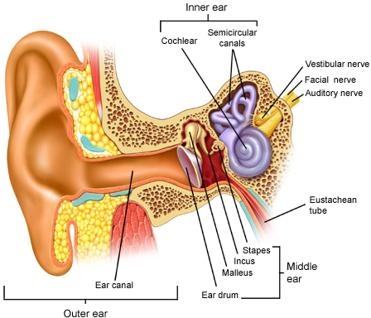
Vestibular System

Slide 5
Hypothesis
Users will be more engaged and less motion sick when in-game visuals exactly match vestibular senses

Slide 6
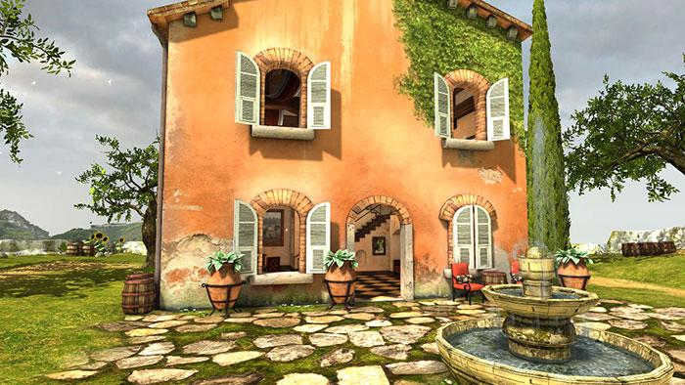
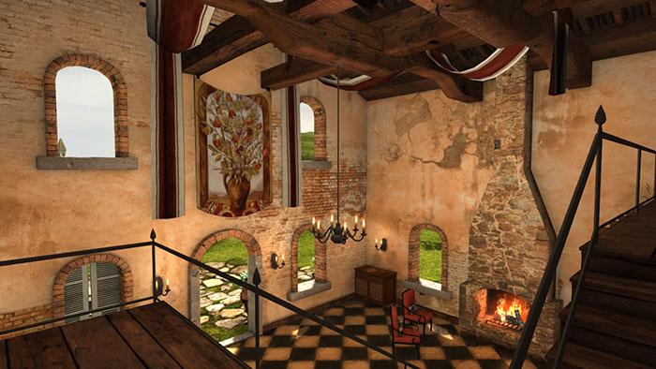
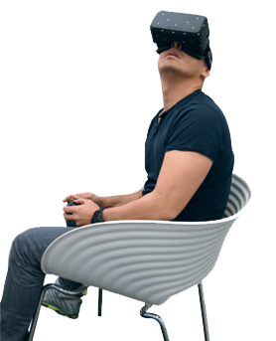
Game Choice
Tuscany Villa Demo
Notes:
Vikas takes over and starts

Slide 7
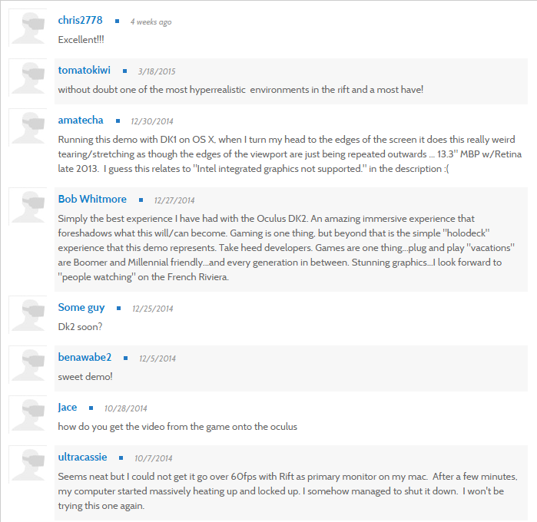
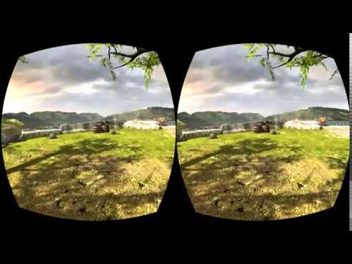
Game Play & User Reviews
Notes:
Vikas

Slide 8
Experimental Setup
Two phases, randomly ordered
Head movement only (matched phase)
Head & in-game body movement (mismatched)
Each participant went through both phases
Each phase followed by a survey
Notes:
Arjun

Slide 9

Participants
12 participants - 7 male and 5 female
Half started with each phase
Notes:
Arjun

Slide 10
Pre-experiment
Brief introduction about the experiment
Instructions on how to use the VR headset
Answer questions, if any
Notes:
Arjun

Slide 11
Matched Phase Tasks
User stands beside the fountain in game
Describe scenery
House
Fountain
Walkway below user
Clouds
Count objects
Butterflies
Flowers
Chairs
Notes:
Arjun

Slide 12
Mismatched Phase Tasks
User moves around and into the house
Describe scenery
Ground
Light fixtures
Sea
Count objects
Flowers
Boats
Notes:
last of Arjun

Slide 13
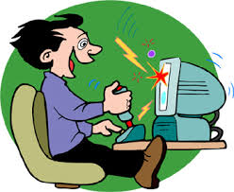

Measures
Simulator Sickness Questionnaire (0-3)
Game Engagement Survey (1-4)
Notes:
Xavier ->

Slide 14
Measures
Simulator Sickness
General Discomfort
Headache
Eyestrain
Nausea
Dizziness
Game Engagement
Lost track of world
Blocked things out
Time slipped away
Drawn into my task
Experience was fun
Notes:
Xavier

Slide 15
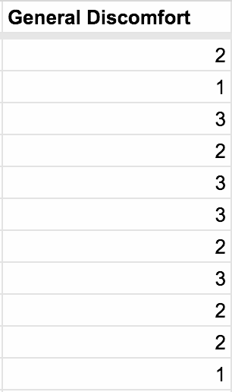
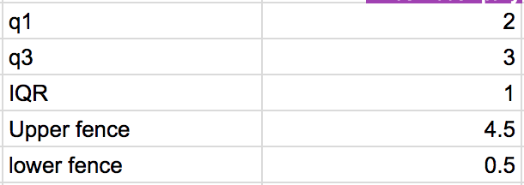
Outliers
Example Results
Outlier Identification
First Quartile
Third Quartile
IQR (Q3 - Q1)
Upper Bounds (Q3 + (1.5 * IQR))
Lower Bounds (Q1 - (1.5 * IQR))
-No outliers lower than lower fence
-No outliers greater than the upper fence
-Allows use of mean to evaluate response
Notes:
Xavier

Slide 16
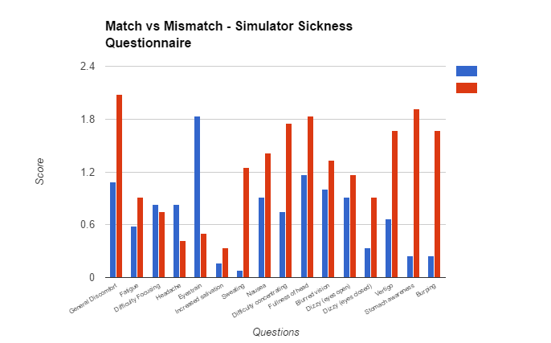
Experimental Results
Match
Mismatch
Notes:
Xavier

Slide 17
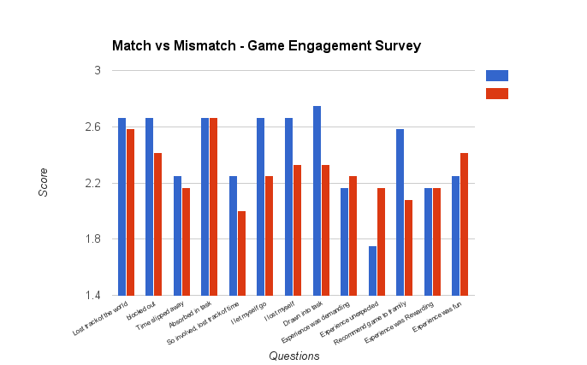
Match
Mismatch
Vestibular Match
Vestibular Mismatch
Notes:
Xavier

Slide 18
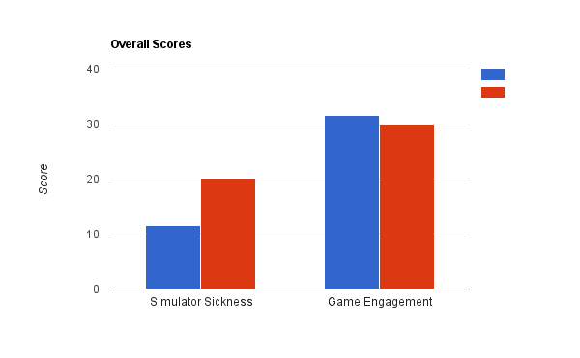
Experimental Results
Survey Results Averages of Vestibular Match vs. Mismatch
Match
Mismatch
31.5
28.8
19.9
11.7

Slide 19
Experimental Results
Vestibular Match
Negative correlation to perceived sickness
Slightly positive engagement correlation
Vestibular Mismatch
Direct correlation to perceived sickness
Slight negative engagement correlation
Notes:
Xavier

Slide 20

Remarks for Developers
Understand effect of content loading
Having short-play sessions or Game Checkpoints
Frame rate and low latency
Limit uncontrolled/rapid motion in-game
Support Short Play Sessions
Playtest with different user experience levels

Slide 21
Thank You!

